Slide 1


Page 1
Benchmarking Foundation Models for
Capsule Endoscopy Lesion Detection
and Segmentation using Vision-Language Models
Neil Lohit Bose (MS Medical Technology, AIIMS-IIT J) | Ishan Jha (B.Tech CS, K.R Mangalam University)
Project Guide: Dr. Sujoy K Biswas
Internship Period: 21 January 2026 – 31 March 2026
IDEAS — Institute of Data Engineering, Analytics and Science Foundation | ISI Kolkata

Slide 2
Page 2
Abstract
This report presents a benchmark evaluation of pretrained foundation models for automated lesion detection and segmentation in capsule endoscopy videos. The study uses the Kvasir-Capsule dataset, focusing on four clinically significant lesion classes: Ulcer, Erosion, Blood-fresh, and Polyp.
Off-the-shelf vision models including CLIP and BLIP-2 were evaluated, demonstrating severe domain shift when applied to capsule endoscopy imagery. MedSAM — a medical image segmentation foundation model — was benchmarked using ground truth bounding boxes as prompts.
Results show pretrained MedSAM achieves a Mean IoU of 0.5101 and Mean Dice of 0.6152, with high precision but very low recall. These findings highlight the domain gap between general medical imaging and capsule endoscopy, justifying the need for domain-specific fine-tuning.
0.5101 Mean IoU
0.6152 Mean Dice
4 Classes Evaluated
1,862 Annotated Frames

Slide 3
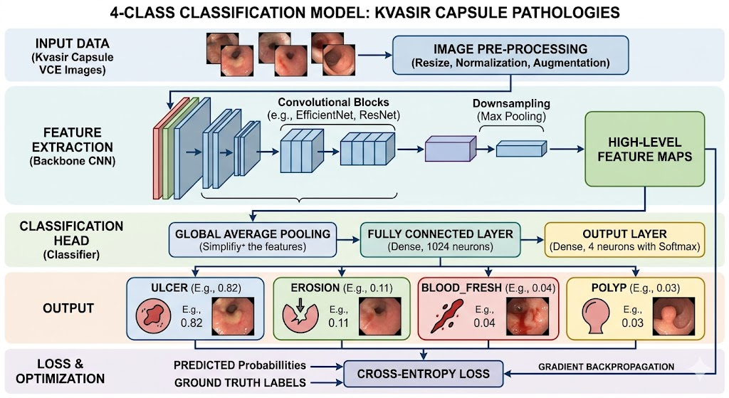
Page 3
Introduction & Background
Capsule Endoscopy
[ IMAGE PLACEHOLDER ]
Capsule Endoscopy Procedure Diagram
or sample Kvasir-Capsule frames
A non-invasive procedure where a patient swallows a camera-equipped capsule that travels through the GI tract, capturing thousands of images over several hours.
• Manual review is time-consuming and error-prone
• AI-assisted detection systems are essential
• Kvasir-Capsule: 117 labelled videos, 4.7M+ frames, 14 finding classes
• This project: 4 critical classes — Ulcer, Erosion, Blood-fresh, Polyp
• 14 labelled videos, 1,862 annotated frames
Foundation Models Evaluated
• CLIP (OpenAI) — Zero-shot classification
• BLIP-2 (Salesforce) — Visual QA
• LLaVA 1.5 7B — Multimodal reasoning
• MedSAM — Medical segmentation (primary benchmark)
• SAM (Segment Anything Model) — baseline

Slide 4
Page 4
Project Objectives
01
Data Pipeline
04
Metrics & Comparison
Build a complete preparation pipeline for Kvasir-Capsule video dataset: video splitting, bounding box annotation overlay using OpenCV, and ground truth JSON generation.
Compute Precision, Recall, F1, IoU, and Dice metrics per class and compare against benchmarks reported in the Kvasir-Capsule paper.
02
Zero-shot Evaluation
05
Domain Gap Analysis
Evaluate off-the-shelf vision models (CLIP, BLIP-2) on capsule endoscopy images and document their failure modes and domain shift characteristics.
Demonstrate the domain gap between general medical imaging and capsule endoscopy, motivating the need for domain-specific fine-tuning approaches.
03
MedSAM Benchmarking
Benchmark pretrained MedSAM on capsule endoscopy lesion segmentation using ground truth bounding boxes as prompts across all 4 lesion classes.
Page 1

Slide 5
Page 5
Methodology
1
2
3
4
5
6
Metadata
Parsing
Data
Pipeline
Video
Assembly
Eval
Script
Vision
Models
MedSAM
Inference
Stage 1–2: Data Preparation
Stage 3–4: Assembly & Validation
Stage 5–6: Model Evaluation
Parsed metadata.json to extract bounding boxes (4-corner → x1,y1,x2,y2). Built OpenCV pipeline to split 14 videos into 85 finding-based clips (30-frame padding), colour-coded ground truth overlays.
Class distribution: Ulcer (29), Erosion (46), Blood-fresh (9), Polyp (1)
MoviePy used to assemble annotated clip videos and highlight reels. Random baseline predictor validated pipeline (F1: 0.3412, Mean IoU: 0.074). Metrics: Precision, Recall, F1, IoU, Dice (micro + macro).
CLIP / BLIP-2 / LLaVA tested on 40 sampled images via HuggingFace API. MedSAM (medsam_vit_b.pth) batched across all 85 clips using GT boxes as prompts → 237 segmentation masks generated.

Slide 6
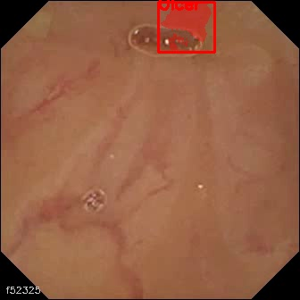
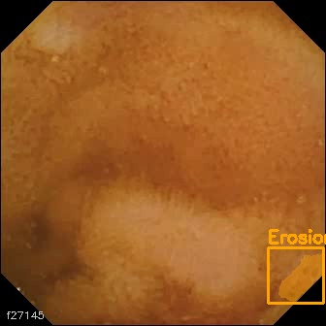
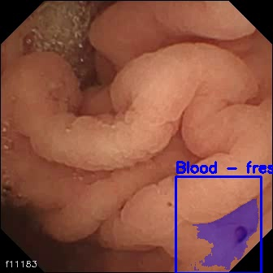
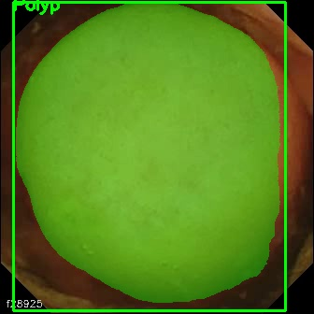
Page 6
Dataset & Data Pipeline
[ Ulcer ]
Sample Frame
Placeholder
[ Erosion ]
Sample Frame
Placeholder
[ Blood-fresh ]
Sample Frame
Placeholder
[ Polyp ]
Sample Frame
Placeholder
Ulcer
Erosion
Blood-fresh
Polyp
117
4.7M+
14
85
1,862
Labelled Videos
(full dataset)
Total Frames
in dataset
Finding
Classes
Clips Generated
(4 classes)
Annotated
Frames used (across 4 classes)
Pipeline Steps:
metadata. Json → BB extraction → Frame extraction → MedSAM inference → Segmentation masks → Metrics (IoU, Dice, F1) → Paper benchmark comparison

Slide 7
Page 7
Off-the-Shelf Vision Models — Results
CLIP (OpenAI/clip-vit-base-patch32)
BLIP-2 (Salesforce/blip-vqa-base)
LLaVA 1.5 7B
40 images tested (10 per class)
Zero-shot text prompts
Overall Accuracy: 30%
• Ulcer: 40%
• Erosion: 70%
• Blood-fresh: 0%
• Polyp: 10%
Key Failure Mode:
Strong majority-class bias — predicted 'Erosion' for nearly all inputs regardless of content.
Visual Question Answering mode
Zero-shot prompting on 40 images
Performance: Effectively 0%
Key Failure Mode:
Generated hallucinated answers entirely unrelated to medical findings. Mapped capsule endoscopy frames to everyday objects.
Conclusion:
Model completely failed to generalise to the medical imaging domain.
Multimodal LLM — Colab (8-bit)
Hardware Constraint:
15.7 GB RAM, no local GPU
→ Run on Google Colab with 8-bit quantization only
Status: Could not be fully benchmarked locally
Setup:- 40 sampled images, zero-shot VQA prompts.
Preliminary findings: Better semantic understanding than CLIP/BLIP‑2 (e.g., correctly described “red lesion” for blood, “irregular surface” for ulcer). Still made classification errors (e.g., confusing erosion with ulcer).

Slide 8
Page 8
MedSAM Benchmark Results (IoU threshold = 0.5)
Class | Precision | Recall | F1 Score | TP | FP | FN
Ulcer | 0.8889 | 0.0843 | 0.1540 | 72 | 9 | 782
Erosion | 0.8800 | 0.2170 | 0.3481 | 110 | 15 | 397
Blood-fresh | 0.0000 | 0.0000 | 0.0000 | 0 | 0 | 446
Polyp | 1.0000 | 0.0714 | 0.1333 | 4 | 0 | 52
Macro Avg | 0.6922 | 0.0932 | 0.1589 | — | — | —
Micro Avg | 0.8857 | 0.0998 | 0.1795 | — | — | —
0.5101
0.6152
0.8857
0.0998
Mean IoU
Mean Dice
Micro Precision
Micro Recall
Moderate spatial overlap
when predictions made
Reasonable mask quality
in prompted segments
High accuracy when
model does predict
Misses 90% of all
annotated findings

Slide 9
Page 9
Comparison with Kvasir-Capsule Paper Benchmarks
Model | Type | Micro F1 | Macro F1 | Notes
ResNet-152 | Fine-tuned (Paper) | 0.7340 | 0.2380 | Supervised, in-domain fine-tuning
DenseNet-161 | Fine-tuned (Paper) | 0.7350 | 0.2460 | Supervised, in-domain fine-tuning
MedSAM (ours) | Zero-shot | 0.1795 | 0.1589 | Pretrained, no capsule endo fine-tuning
Random Baseline | Baseline | 0.3412 | — | Validates pipeline correctness
Key Insights
▲
MedSAM achieves strong spatial quality when it predicts: Mean IoU 0.5101, Mean Dice 0.6152 — showing effective prompting capability.
▼
Recall of 0.0998 means MedSAM misses ~90% of annotated findings in zero-shot mode — far below fine-tuned ResNet/DenseNet.
●
Blood-fresh received ZERO predictions — visually out-of-distribution for MedSAM's training set (endoscopy bleeding ≠ standard medical imaging blood).
►
Fine-tuned CNNs (ResNet-152, DenseNet-161) still outperform zero-shot MedSAM by 4× on Micro F1, confirming domain-specific training is essential.

Slide 10
Page 10
Conclusions & Future Work
Conclusions
Future Work
1. Successfully built a complete data preparation & evaluation pipeline for Kvasir-Capsule
Fine-tune MedSAM
Fine-tune MedSAM checkpoint on Kvasir-Capsule dataset to close the domain gap and improve recall significantly
2. CLIP (30% accuracy) and BLIP-2 (hallucinations) failed entirely on capsule endoscopy imagery
Video RAG Pipeline
3. MedSAM zero-shot Micro F1 = 0.1795 — far below fine-tuned ResNet-152 (0.734) and DenseNet-161 (0.735)
Explore Video RAG with Vision LLMs for natural language querying over capsule endoscopy video archives
LLaVA Full Evaluation
4. Mean IoU 0.5101 & Dice 0.6152 show adequate mask quality when prompted, but recall is critically low
Full benchmark of LLaVA 1.5 7B with dedicated hardware (A100 GPU) for multimodal clinical QA
5. Blood-fresh: 0 predictions — an entirely out-of-distribution finding for MedSAM
All 14 Classes
Extend pipeline to all 14 Kvasir-Capsule finding classes beyond the initial 4 critical classes
6. Pretrained foundation models are insufficient for capsule endoscopy without domain-specific adaptation
Temporal Modelling
Leverage video-level context (optical flow, temporal consistency) to improve detection across frame sequences

Slide 11
Page 11
Tools, Links & References
Project Links
Tools & Libraries
GitHub Repository: GitHub Link
Python 3.12 · OpenCV 4.x · MoviePy 2.0 · HuggingFace Transformers 5.x · MedSAM / segment_anything · PyTorch 2.x · NumPy · Matplotlib · Google Colab
Google Drive: Gdrive
(Code, MedSAM inference scripts, data pipeline, media outputs, metrics JSON)
References
[1] Smedsrud, P.H., et al. (2021). Kvasir-Capsule, a video capsule endoscopy dataset. Scientific Data, 8, 142.
[2] Ma, J., et al. (2024). Segment Anything in Medical Images. Nature Communications, 15, 654.
[3] Kirillov, A., et al. (2023). Segment Anything. Proceedings of ICCV 2023.
[4] Radford, A., et al. (2021). Learning Transferable Visual Models From Natural Language Supervision. ICML 2021.
[5] Li, J., et al. (2022). BLIP: Bootstrapping Language-Image Pre-training for Unified Vision-Language Understanding. ICML 2022.

Slide 12
Page 12
Thank You
Neil Lohit Bose · Ishan Jha
Mentor: Dr. Sujoy K Biswas
IDEAS — Institute of Data Engineering, Analytics and Science Foundation | ISI Kolkata
Benchmarking Foundation Models for Capsule Endoscopy Lesion Detection and Segmentation · January–March 2026

